Slide 1
Module 2 Multidimensional data representation and manipulation
Lesson 3: Overview of Microsoft MDX
Notes:
Welcome to Lesson 3 of Module 2 on Multidimensional data representation and manipulation
Opening question
- What is the commercial impact of Microsoft MDX?

Slide 2
Lesson Objectives
Explain basic MDX terminology
Reflect on MDX commercial impact
Notes:
This lecture introduces the Microsoft Multidimensional Expressions (MDX) language.
Cover data representation of MDX

Slide 3
Multidimensional Expressions (MDX) History
Defacto standard developed by Microsoft and later by the XMLA Council
1997 MS OLAP specification
1998 MS OLAP services release
MS 2005 MDX revision
2001 mdXML specification by XMLA Council
Notes:
De facto standard embraced by a wide variety of business intelligence vendors
MDX was first introduced as part of the OLE DB for OLAP specification in 1997 from Microsoft. It was invented by a group of SQL Server engineers including Mosha Pasumansky. The specification was quickly followed by commercial release of Microsoft OLAP Services 7.0 in 1998 and later by Microsoft Analysis Services. The latest version of the OLE DB for OLAP specification was issued by Microsoft in 1999.
In Analysis Services 2005, Microsoft added some extensions, most notably subselects. This new variation is sometimes referred to as MDX 2005.
XMLA Council specified mdXML as the query language in 2001 as part of the XML for Analysis standard. MDX statement is enclosed in the <Statement> tag

Slide 4
MDX Usage
Foundation for Microsoft products and open source analytics software
SQL Server Analysis Services and Excel Pivot Tables
Hyperion, IBM, SAP, and other vendors
Foundation for open source projects: JPivot, Pivot4J, and Pentaho
Notes:
MDX became the base of many Microsoft products and features such as SQL Server Analysis and Excel Pivot Tables
MDX was also adopted by wide range of vendors from both commercial side and open source side. Prominent commercial vendors are Hyperion, IBM, and SAP in addition to Microsoft. Prominent open source vendors are Olap4J, Pivot4J, and Pentaho.

Slide 5
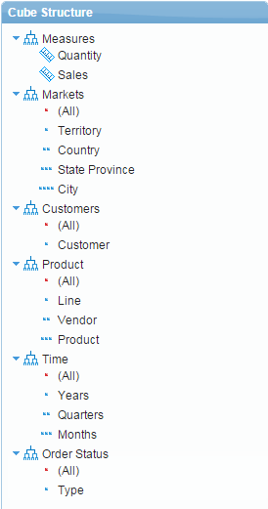
Example MDX Cube Structure
Notes:
MDX cube structure for SteelWheels cube
Dimensions
Markets with hierarchical attributes of Territory, Country, State Province, City
Customer
Product with hierarchical attributes Line, Vendor, Product
Time with hierarchical attributes Years, Quarters, Months
Order status with Type attribute
Measures
Quantity
Sales

Slide 6
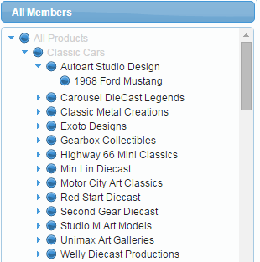
Attribute Hierarchy and Members
Line attribute member
Vendor attribute member
Product attribute
member
Product attribute hierarchy
Line
Vendor
Product
Notes:
Members for the Line, Vendor, and Product attributes of the Product dimension

Slide 7
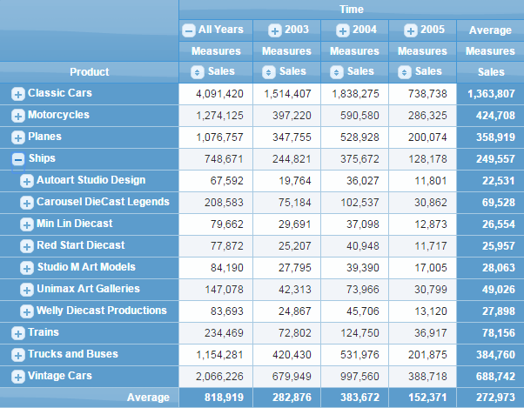
Steel Wheels Cube Display

Slide 8
MDX Terminology Notes
Tuple
Cell identifier
One member from each dimension
Axis: dimension selected in a query (source cube cells)
Slicer: combination of dimension members (result cube cells)
Notes:
Tuple
Combination of members
Identifies a cell
Measures: numeric values in cells; same definition as already given
Dimensions
Main business concepts
Geography, time, products, customers
Measures can also be aggregated. Examples like total, count, min…etc.
Dimensions cannot be aggregated.
Slicer performed on dimensions not shown in axes.

Slide 9
Summary
Foundation for several Microsoft products
Evolved into a de facto standard for data cubes
Basic data cube features demonstrated
Notes:
Multidimensional expressions (MDX)
Microsoft: MDX language and analysis server
MDX is a de facto standard as it has been adopted by many vendors
Only provided a brief introduction to basic concepts

